Slide 1
general conference leadership development conference for NEWLY ELECTED LEADERS
March 12, 2024
CASE STUDY
Role of the Working Policy
and Church Manual
Karnik Doukmetzian
Hensley Moorooven

Slide 2
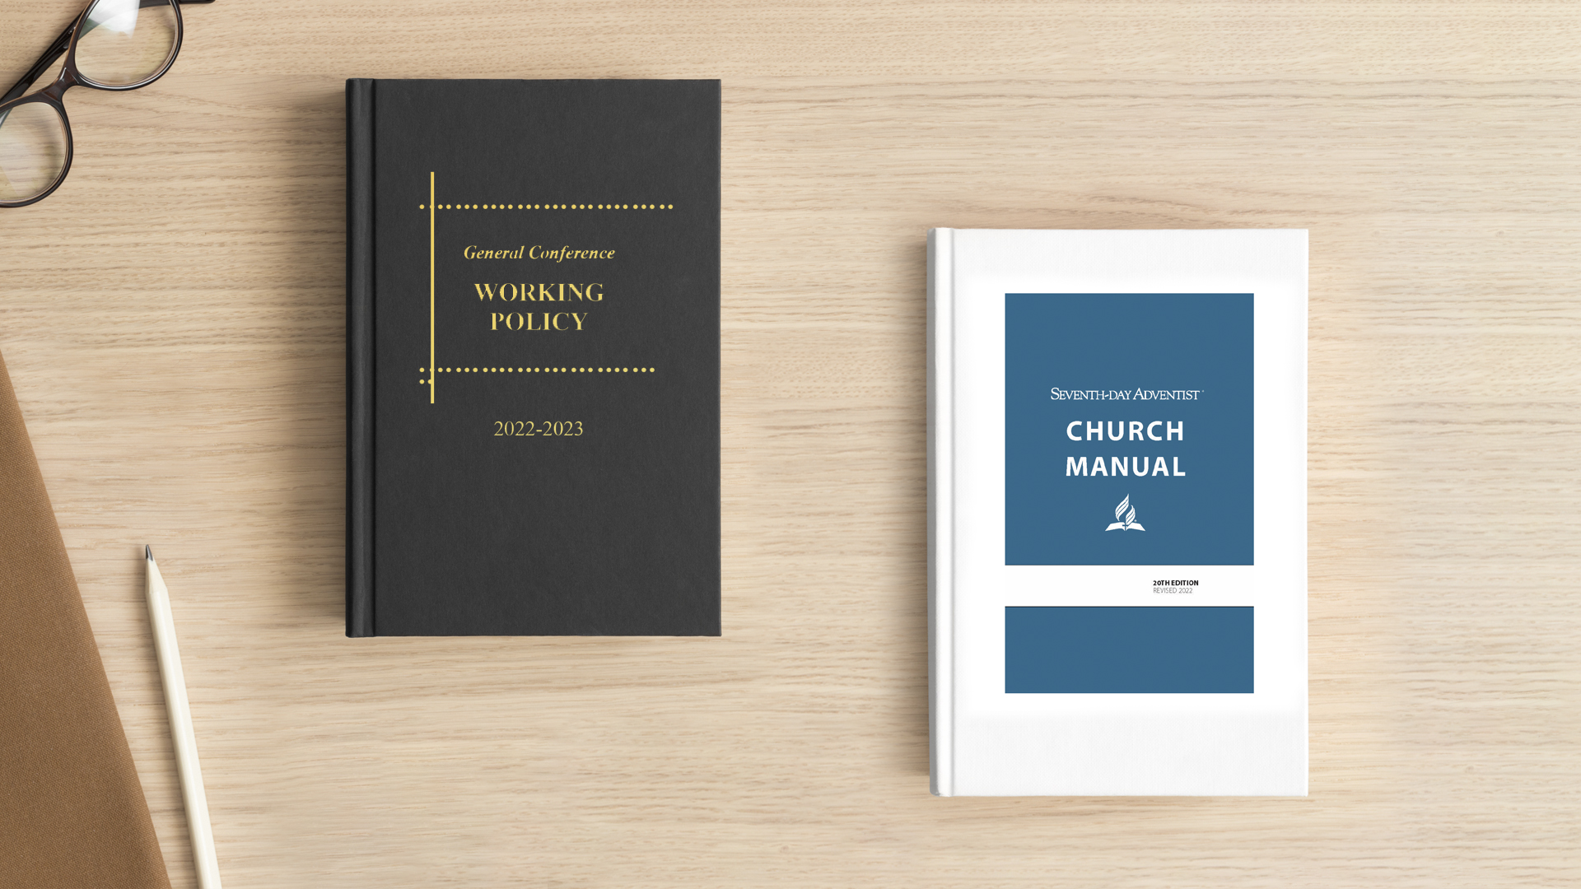
Case Study

Slide 3
Case Studies from the
Model Constitution and Bylaws
Section D: GC Working Policy

Slide 4
Article III-Constituency Meeting Representation
B. The _______ Conference Executive Committee reserves the right to accept or reject any recommendation from churches regarding delegates.
C. Distribution: Not less than four (4) weeks prior to the Meeting, an information package or booklet for each Meeting shall be provided to each Delegate. Copies of the information package or booklet shall also be available for distribution at the Conference office, and at the Meeting, to other Church members requesting it. The information package or booklet shall include sufficient information to enable each Delegate to function in a manner consistent with her/his responsibility and with the published purposes and agenda of the meeting, including, but not limited to, the following:
Example 1

Slide 5
1) The agenda
2) A statement concerning the organization and procedures of the Meeting and the responsibilities of the Delegates
3) List of all Delegates, and the Church or other Conference entity they represent
4) Minutes of the previous regular Meeting, and minutes of all special Meetings, if any, held since the last regular Meeting, as reviewed and approved by the Executive Committee
5) Current financial statements of the Conference and the Association
6) A copy of the Constitution and Bylaws under which the Meeting is called
7) A copy of any proposed amendments to the Constitution and Bylaws
8) A copy of the current General Conference Rules of Order
Example 1

Slide 6
ARTICLE III—RELATIONSHIPS
The Union Conference is a member unit of the global Seventh-day Adventist Church and is located in the territory of the ________Division of the General Conference of Seventh-day Adventists. The purposes, policies, and procedures of this union conference shall be in harmony with the working policies and procedures enacted by the executive committee of the ____________Division or the General Conference of Seventh-day Adventists. This union conference shall pursue the mission of the Seventh-day Adventist Church in harmony with the Fundamental Beliefs, programs, initiatives, and actions adopted and approved by the General Conference of Seventh-day Adventists at its sessions.
MODEL LANGUAGE

Slide 7
ARTICLE III—RELATIONSHIPS
The Union Conference of Seventh-day Adventists is part of the ________Division of the General Conference of Seventh-day Adventists, a world Church organization. In general, the purposes, policies, and procedures of the Union shall be in harmony with the working policies and procedures enacted by the executive committee of the ____________Division of the General Conference of Seventh-day Adventists, to the extent that these are consistent with the articles of the Union’s Constitution and Bylaws. The Union shall pursue the mission of the Church within the doctrinal guidelines adopted and approved by the General Conference of Seventh-day Adventists in its quinquennial sessions.
EXAMPLE 2

Slide 8
6. VOTING AT SESSIONS
Resolutions are to be decided on a show of hands unless a ballot is properly demanded.
Each Delegate to a Session may present in person or by proxy has one vote both on a show of hands and a ballot.
7. PROXIES
A Delegate may validly appoint a proxy by notice in writing which:
states the name and address of the delegate appointing the proxy;
identifies the person appointed to be that delegate’s proxy and the Meeting in relation to which that person is appointed;
is signed by or on behalf of the delegate appointing the proxy, or is authenticated in such manner as the Secretary may determine.
A proxy need not be a Delegate of the Session.
EXAMPLE 3

Slide 9
Actionable Advice
Secretariat (and the other two officer groups) should be involved at every level
Educating ourselves should be a priority
Orientation of Committees and constituencies is crucial
Accuracy is critical
In Essentials Unity, In Non-Essentials Liberty, In All Things Charity

Slide 10
Case Study from the
Church Manual

Slide 11
Case Study

Slide 12
Dr. D. Kay, a dentist, is a member of the “All Saints Seventh-day Adventist Church” in Soda Spring, Idaho. He divorced his wife to marry his associate, Dr. Fang. After one month, he asked for his membership to be transferred to the “Ideal Seventh-day Adventist Church,” in Cool, Texas.
Case Study

Slide 13
Dr. D. Kay, a dentist, is a member of the “All Saints Seventh-day Adventist Church” in Soda Spring, Idaho. He divorced his wife to marry his associate, Dr. Fang. After one month, he asked for his membership to be transferred to the “Ideal Seventh-day Adventist Church,” in Cool, Texas.
Case Study
What should the local church where his membership resides do?

