Slide 1
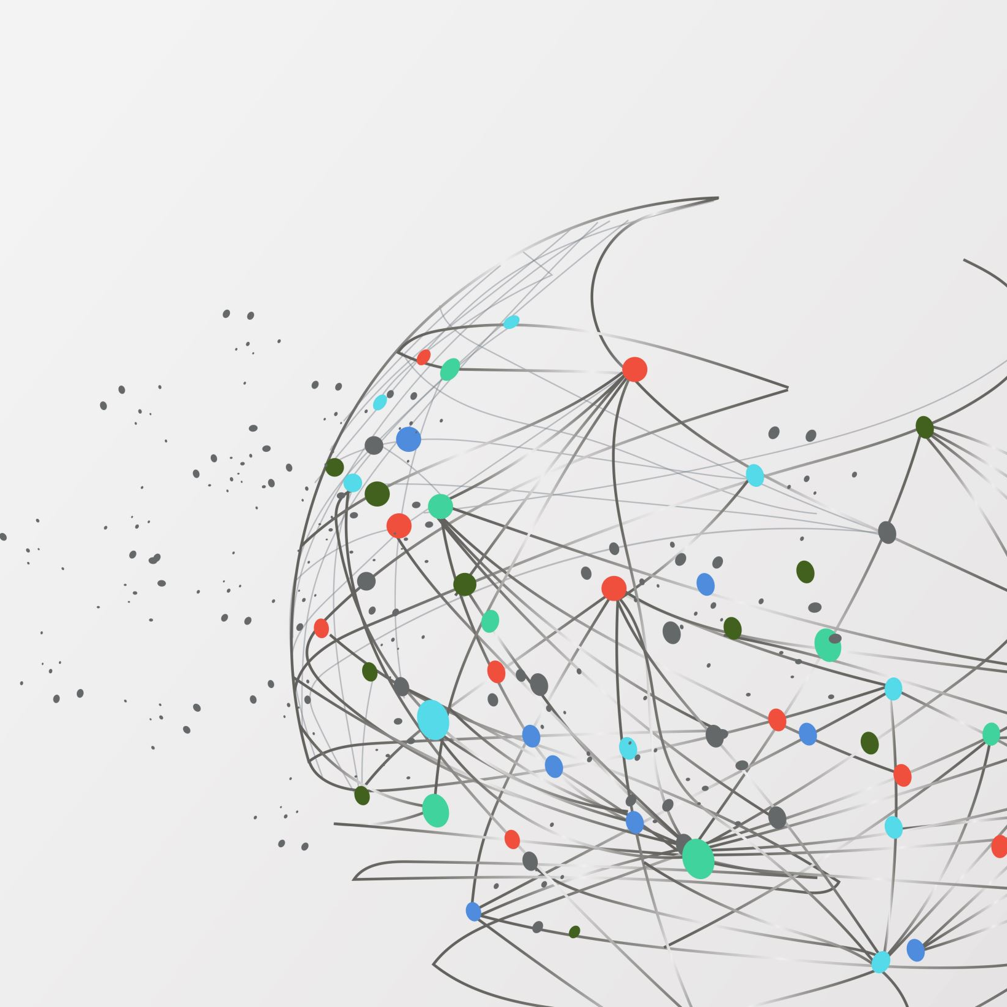
Ethics, Empathy and Integrity
A Framework for Decision Making
General Conference Leadership Development Program:
Newly Elected Leaders
March 12, 2024

Slide 2
Defining Ethics
Ethics refers to standards of behavior that tell us how human beings should act!

Slide 3
Defining Empathy
Empathy refers to understanding the thoughts and needs of others!

Slide 4
Defining Integrity
Integrity refers to being honest and truthful in all situations!

Slide 5
A Conceptual Model
Empathy
Ethics
Integrity

Slide 6
Ethics is not…
Defining Ethics
Feelings
RELIGION
Culture
Obeying the law Science

Slide 7
Five Sources of Ethical Standards
The Utilitarian Approach
The Rights Approach
The Fairness of Justice Approach
The Common Good Approach
The Virtue Approach

Slide 8
The ethical action that produces the most good or does the least harm
The Utilitarian Approach
The Rights Approach
The Fairness of Justice Approach
The Common Good Approach
The Virtue Approach

Slide 9
The ethical action that best protects and respects the moral rights of those affected
The Utilitarian Approach
The Rights Approach
The Fairness of Justice Approach
The Common Good Approach
The Virtue Approach

Slide 10
The ethical action that treats all human beings equally, or if unequally, then fairly based on some defensible standard
The Utilitarian Approach
The Rights Approach
The Fairness of Justice Approach
The Common Good Approach
The Virtue Approach

Slide 11
The ethical action that contributes to the good of the community
The Utilitarian Approach
The Rights Approach
The Fairness of Justice Approach
The Common Good Approach
The Virtue Approach

Slide 12
The ethical action that is consistent with certain ideal virtues
The Utilitarian Approach
The Rights Approach
The Fairness of Justice Approach
The Common Good Approach
The Virtue Approach

Slide 13
Finally, brethren, whatever things are true, whatever things are noble, whatever things are just, whatever things are pure, whatever things are lovely, whatever things are of good report, if there is any virtue and if there is anything praiseworthy—meditate on these things.
Philippians 4:8

Slide 14
A Framework for Thinking and Acting Ethically
1
Recognize an Ethical Issue
2
Get the Facts
3
Evaluate Alternative Actions
4
Make a Decision and Test It
5
Act and Reflect on the Outcome

Slide 15
Ethical Judgment Traps
Scripts
Busyness and Distraction
Moral Exclusion

Slide 16
Scripts
“When I was dealing with the first trickling-in of field reports that might have suggested a significant problem with the Pinto, the reports were essentially similar to many others that I was dealing with (and dismissing) all the time . . . I was making this kind of decision automatically every day. I had trained myself to respond to prototypical cues, and these didn’t fit the relevant prototype for crisis cases.”
Dennis Gioia, Ford Company Recall Coodinator

Slide 17
Busyness and Distraction
“After the data was weighed and the variables analyzed, only one variable could be used to predict who would stop to help and who wouldn’t. The important factor was not personality type or whether a student’s career or the parable of the Good Samaritan was foremost in his mind. It was whether or not he was in a hurry . . . The study made it hard not to conclude that ethics becomes a luxury as the speed of our daily lives increases.”
John Darley and Daniel Batson

Slide 18
Moral Exclusion
Some people are seen as outside the boundaries where moral considerations and fairness apply.
This mind-set is:
Influenced by culture
Included in language
Imparted through stereotypes

Slide 19
Ethical Judgment Pressure Points
Pressure
Opportunity
Rationalization

Slide 20
7 Signs of Ethical Collapse
Pressure to maintain those numbers
Fear and silence
Young ‘Uns’ and the Bigger-Than-Life President/CEO
Weak Boards
Conflicts of Interest Not Addressed
Mentality: Success is All that Matters
Goodness in Some Areas Atones for Evil in Others
Marianne Jennings

Slide 21
Impact of Ethical Collapse
Damage to reputation
Loss of trust and credibility
Legal and financial consequences
Decreased employee morale and productivity

Slide 22
When you weaken the confidence (trust) of God’s people in their leaders, you weaken the cause of God.
Letter 13, 1871

Slide 23
Therefore, since it is by God’s mercy that we are engaged in this ministry, we do not lose heart. We have renounced the shameful things that one hides; we refuse to practice cunning or to falsify God’s word; but by the open statement of the truth, we commend ourselves to the conscience of everyone in the sight of God.
2 Corinthians 4:1-2

Slide 24
Responsibility of Leaders
Subscribe to ethical values personally
Set the tone for ethical values corporately

Slide 25
Responsibility of Leaders
Live according to biblical values and principles
Act always in the best interest of the Church
Preserve transparency in decision-making processes
Disclose conflicts of interests

Slide 26
Shared Values General Conference of Seventh-day Adventists
We value the Bible as the primary reference for life’s direction and qualities
We value excellence in all that we do
We value ethical and moral conduct at all times and in all relationships
We value creativity and innovation in the completion of our mission
We value honesty, integrity, and courage as the foundation of all our actions
We value the trust placed in us by colleagues and by the world church membership
We value people as children of God and therefore brothers and sisters of one family

Slide 27
Ethical Responsibilities as Employer
Ethical Responsibilities as Employees
Equal opportunity employment
Equal fairness and non-discrimination
Compliance with laws of the land
Loyalty and fulfillment of contractual obligations
Atmosphere of safety and happiness
Respect for human dignity and individuality
Life consistent with church message and mission
Respect for church-owned assets
Respect for colleagues
Efficiency and attention on the job
Personal integrity in financial matters
Avoiding inappropriate influence
Maintaining an ethical environment in the workplace

Slide 28
“We try to live in such a way that no one will ever be offended or kept back from finding the Lord by the way we act, so that no one can find fault with us and blame it on the Lord. ”
2 Corinthians 6:3

Slide 29
A Conceptual Model
Empathy
Ethics
Integrity

Slide 30
The greatest want of the world is the want of men [persons] – persons who will not be bought or sold, persons who in their inmost souls are true and honest, persons who do not fear to call sin by its right name, persons whose conscience is as true to duty as the needle to the pole, persons who will stand for the right though the heavens fall.
Ellen G White – Education p. 57

Slide 31
Ethics, Empathy and Integrity
A Framework for Decision Making
General Conference Leadership Development Program:
Newly Elected Leaders
March 12, 2024

