Slide 1
How does the Church work?
The Role of Working Policy
and
Committees
Notes:
How does the Church work? The Role of Structure, Working Policies, and Committees
Anyone who has struggled with the niceties of English grammar and usage will resonate with George Bernard Shaw, the Irish poet, and playwright, who reputedly said, “Britain and the United States are two countries divided by a common language.” One hundred and fifty years later it is still true. Cars have bonnets, wings, and boots in England. By contrast in America, automobiles have hoods, fenders, and trunks. In England, a hood is something on a coat to keep you warm and dry. A fender is a guard around a fireplace to stop burning coals from falling out, and elephants have trunks! We smile at the potential confusion, innocent misunderstanding, or amusement that may arise because of words used in a different context. Sometimes we use words and attribute our understanding without pausing to reflect how it might be understood by others. This is true both inside and outside the Church.
Policy - A stick, an inducement, or a boring technicality?
Having served as an executive secretary at union and division level, one word within the Church context, which generates strong feelings and often misunderstandings is policy.

Slide 2
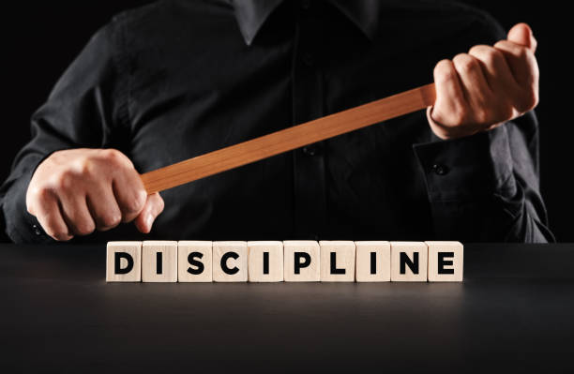
Policy myths
Policy Myths
Notes:
For some policy is viewed as a stick: something to metaphorically bludgeon people and entities to make them reluctantly do what they do not necessarily want to do.

Slide 3
Policy Myths
Policy is an
Inducement
Notes:
Others view it as an inducement or the proverbial carrot, which is always out of reach but keeps the donkey going in the right direction.

Slide 4
Policy Myths
Policy is a boring technicality
Photo by Sander Sammy on Unsplash
Notes:
Then some regard policy as a boring technicality dreamed up by ecclesiastical bureaucrats. All three suppositions are classic examples of truthiness. Statements that sound as if they are true but are not. The facts and evidence do not support their claims.
.
https://www.merriam-webster.com/dictionary/truthiness

Slide 5
Policy Reality
Policy is like a skeleton that provides support and protection for the Church and allows us to move forward in a coordinated way
Notes:
Policy is not a stick, an inducement, or a boring technicality. Policy functions like our skeleton. It provides support and protection for the Church and allows us to move forward in a coordinated way

Slide 6
30 Second Challenge
What are the core governance documents of the Seventh-day Adventist Church?
Photo by Agê Barros on Unsplash

Slide 7
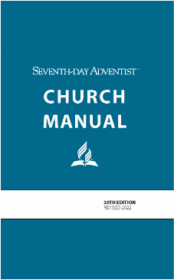
Core Governance Documents
Statement of Fundamental Beliefs
Articulate the Church’s understanding of the Bible and its teachings
Church Manual
From its inception in 1931 was “an endeavor first to preserve all the good actions taken through the years and then to add rules required by the Church’s increasing growth and complexity.”
Notes:
There are three core documents:
Statement of Fundamental Beliefs – which articulate the Church’s understanding of the Bible and its teachings
Church Manual – which from its inception in 1931 was “an endeavor first to preserve all the good actions taken through the years and then to add rules required by the Church’s increasing growth and complexity.”

Slide 8
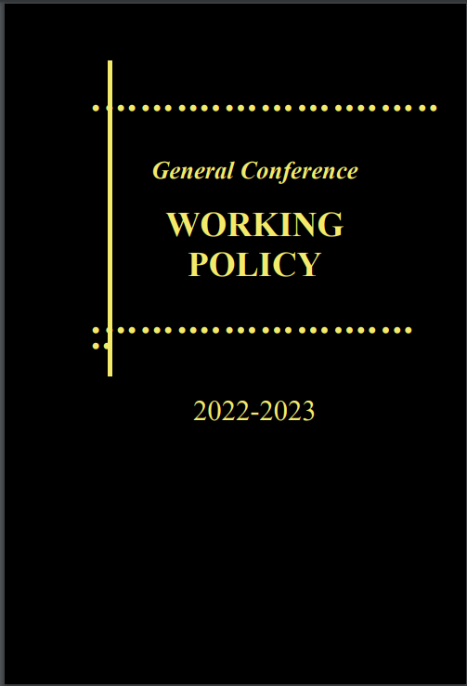
Core Governance Documents
General Conference Working Policy
…is “the authoritative voice of the Church in matters relating to the administration of the work of the Seventh-day Adventist denomination in all parts of the world”
(GCWP – Introduction)
Notes:
General Conference Working Policy, which is “the authoritative voice of the Church in matters relating to the administration of the work of the Seventh-day Adventist denomination in all parts of the world.”(GC WP Intro) From this comes Division WP, the model constitution and bylaws for the unions, and their constituent entities, and eventually local working policy
These documents are dynamic and may be modified following clearly defined consultative processes.
General Conference Working Policy is amended annually at the executive committee’s annual council, again following a period of consultation.

Slide 9
Organizational Wisdom
GC & Divisions
Unions
Departments
Policy
Notes:
Organizational myth and wisdom
A commonly held myth is that changes to all these documents come “from above”, some nebulous committee located in the General Conference building in Silver Spring. Amendments may come from GC committees, but often they start in a conference, or union, where a potential improvement or change is identified. This is passed up through the organizational structure, allowing for input and collective wisdom, to shape and modify the proposal enroute.
For example: An example of a change that impacted working policy was the implementation in Europe of the General Data Protection Regulation or as it is more commonly known GDPR. This brought in legal restrictions on how personal data could be managed and impacted policy. Although local to Europe, it soon became obvious that other countries would implement similar legislation, and the interlinking of organizations meant that policy needed to be amended.
Changes that are generated at the General Conference are shared in reverse allowing for the same input. The nature of this process means that changes do not happen overnight. At times it may seem frustratingly slow, however, consultation and collective decision-making are key to Church governance.

Slide 10
Interrelated Documents
Statement of Fundamental Beliefs
Church Manual
Working Policy
Notes:
Interrelated documents
Elder Hensley Moorooven will talk more about the Church Manual and working policy, so it is sufficient to say that the Church Manual provides the framework for how members operate in the local church. The Working Policy defines our global Church organizational structure and principles. It defines how the constituent parts of the structure relate to each other and sets out procedures and practices which facilitate cohesive, consultative decision-making. The Statement of Fundamental Beliefs rests on both. Someone wanting to join the Seventh-day Adventist Church needs to study and understand what we believe. BUT when they decide to join, there needs to be a well-functioning organized church to receive them. Take away any one of the three and the mission of the Church will suffer.

Slide 11
Purpose of Policy
Provides a decision-making framework
that ensures:
consistent administration
everyone who works for the Church is treated fairly
protection from erratic and autocratic leadership
It avoids widely differing patterns of
action
Photo by Brian Patrick Tagalog on Unsplash
Notes:
Purpose of Policy
The end of the twentieth and the start of the twenty-first centuries have seen exponential growth in globalization. Brands such as Apple, McDonalds, IKEA, and Starbucks are instantly recognized almost anywhere.
Fundamental to their success is whether we are in London, Lima, Lagos, or Lahore we know we will receive the same quality of service and products. Working Policy helps us achieve the same thing.
Policies provide the Church with a decision-making framework, which ensures:
consistent administration
everyone who works for the Church is treated fairly
protection from erratic and autocratic leadership
It avoids widely differing patterns of action

Slide 12
Interdependence
Each level depends on the other
Delegated authority
All levels are dependent on God
Photo by Aida L on Unsplash
Notes:
Interdependence
When looking at the principles underlying our policies, they can be summarized by one word -interdependence. Each level is dependent on the other. No level is self-determining. All levels are dependent on God because without His blessing it does not matter how good our policies are, we will flounder and fail.

Slide 13
Interdependence
Representation
Shared responsibility
Integrity of each entity
Photo by Aida L on Unsplash
Notes:
Each level of the Church functions as a constituency-based system, which provides for representation from its constituent parts.
A General Conference Session has representatives from all administrative levels, with allocations ensuring that lay members, as well as administrators, have a voice.
Shared responsibility
Representation is one way of ensuring shared responsibility, others are:
Administration is shared between officers
Decision-making authority rests not with individuals, but with committees
The acceptance by all entities of a common mission, purpose, belief, and commitment to collaborative decision-making.
Working policy ... “is the authoritative voice of the Church in matters relating to the administration of the work of the Seventh-day Adventist denomination in all parts of the world. It is to be adhered to by all denominational organizations.” (GCWP – Introduction)
Recognizing the integrity of each entity.

Slide 14
Multiple Layers
Working Policy provides a basic
framework
Some things apply at all levels
Some provisions apply globally but
may be adjusted by divisions and
unions
Policies should always be in harmony
with the higher organizations
Photo by Brian Patrick Tagalog on Unsplash
Notes:
Multiple layers
Policy provides unity, but unity does not mean uniformity and there is some latitude in matters of practice. Working Policy provides a basic framework. Some things apply at all levels, for example defining the administrative relationships between entities, conflict of interest, the Sabbath School curriculum, departmental scope, and responsibilities. Some provisions apply globally but are then further adjusted by divisions and unions. Two simple examples are global tithe sharing responsibilities and policies dealing with abuse.
Working policy defines the tithe-sharing percentage that should be returned to the General Conference, but then provide a degree of latitude for divisions, and unions in consultation, to agree on additional tithe-sharing percentages, within certain parameters.
Every entity has a responsibility to develop policies and practices to deal with abuse. The division may develop templates and models, requiring unions to adapt them to take into account local realities and legal reporting requirements. The overarching principle is expanded and adapted at each level creating local working policies. However, policies should always be in harmony with the higher organizations.

Slide 15
Ecclesiastical vs Institutional
Working policy provides guidance as to how the ecclesiastical and institutional needs of the church can
co-exist
Notes:
Ecclesiastical vs Institutional
Working policy determines how we relate to each other, but we do not live in an isolated ecclesiastical bubble. The church owns properties, operates institutions, and employs people. This requires different organizational structures and processes.
For example: In the ecclesiastical world, a union executive committee has a significant number of employees, is chaired by the union president, and is heavily involved in management decisions. Between sessions, the officers of the union are responsible to the executive committee. Each entity is not completely autonomous as it is linked with other entities.
In the institutional world, each entity is a separate, stand-alone organization. Very few employees are voting members of the board. The board chair is always someone external. Their purpose is to deal with the governance and policies of the organization, ensuring that the institution runs smoothly, and can meet its financial obligations.
These two organizational forms are not mutually exclusive, rather they can work in cooperation and partnership. Working policy provides guidance as to how these two can co-exist.
The Church has the advantage of being able to lean on the best practice in governance and policy with input from a sophisticated global network, which would be the envy of many commercial organizations.

Slide 16
Committees
What is the purpose of the committee?
What is its authority/responsibility?
Membership?
Is it an ‘Adhoc’ or ‘Standing’ committee?
Notes:
Implementing policy
The best policies in the world are ineffective if they are not implemented. Using committees as the vehicle for implementing policies provides for combined wisdom, insight, and understanding.
When considering committees there are 4 questions that need to be answered:
What is the purpose of the committee?
What is its authority/responsibility?
Who should be a member?
Is it an ‘Ad hoc’ or ‘Standing’ committee?

Slide 17
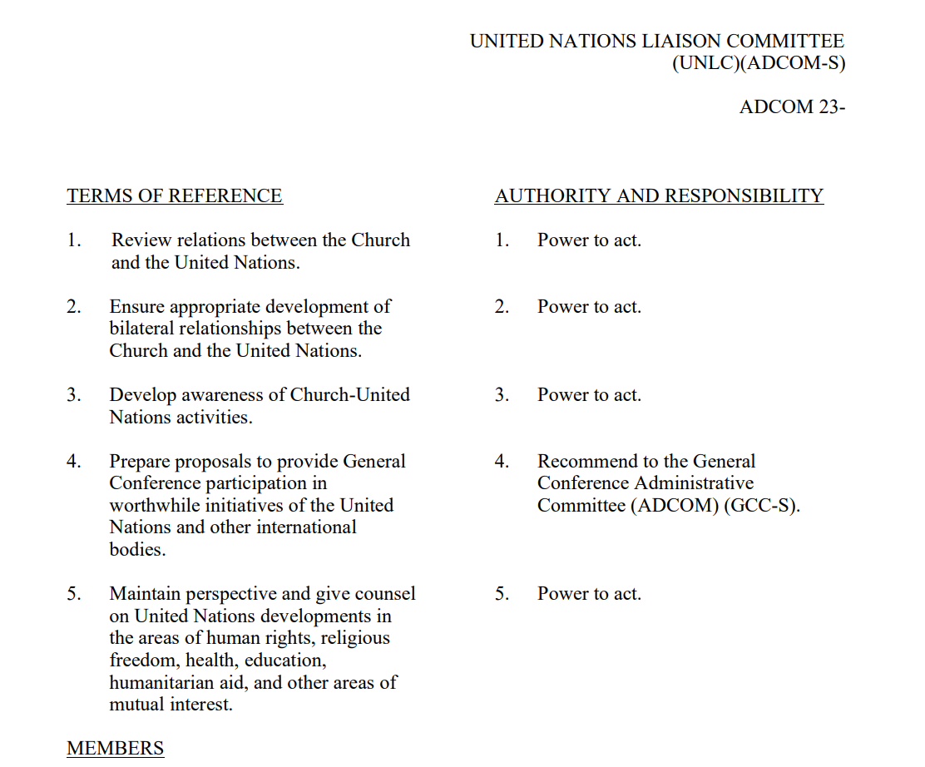
Committees
Notes:
Every committee when voted must have a definition of its role and function consisting of:
Terms of Reference
Authority and responsibility
Membership
Ensure the range of expertise needed
Fewer rather than more members
Diversity or perspective
What is the life of the committee? When will the function and membership be reviewed?
Committees should be reviewed at the beginning of every quinquennium, quadrennium or triennium as appropriate. The question should be asked whether it is still necessary, and membership reviewed.
AdHoc vs Standing
An adhoc committee which meets as and when it is needed. A standing committee meets on a regular basis at a regular time.

Slide 18
Weakest Link
Consistent application increases trust
Inconsistent application brings hurt and confusion for the individual, fear
Photo by Aida L on Unsplash
Notes:
The weak link in the chain
The success or failure of even the best policy is determined by the degree of trust people have in the organization and in the individuals who lead it. The quickest way to undermine a leader is to demonstrate that they are untrustworthy, or incompetent. In contrast, a leader who consistently demonstrates integrity and competence will produce trust.
Organizational trust is determined by how closely a person aligns with its mission, vision, and goals. Is the organization consistent in how it relates to issues, treats people, and implements its policies?
When things go wrong, it is usually not the “fault” of the policy, rather how it has been applied. For example, Working Policy has provisions to deal with a moral fall or inappropriate activities which come under the umbrella term “for cause”. When the policy is applied consistently, with the same consequences for all, clarity, and trust increase. When outcomes are inconsistent, the result is hurt and confusion for the individual, fear, distrust in leadership, and often a period of paralysis in the organization.
Room for improvement
Looking at the comprehensive nature and size of our policies today it is easy to forget that they have developed and matured over many years. They reflect a depth and wealth of experience. They have grown, been amended, and sometimes repealed, in response to the needs of the Church. Change originates from proven best practice, occasionally painful lessons learned from mistakes, or changing circumstances.
For example, the 2014 Annual Council authorized all policies relating to International Service Employees be removed from the main working policy book and delegated the General Conference Mission Board to review and maintain these policies.
Policy is dynamic. It can be amended, but the rationale needs to be built, and processes need to be followed. This way everyone is protected, consistency and sound decision-making are maintained. No one segment of the Church is favored or disadvantaged.

Slide 19
Availability
True or false
Working policy may be posted on the internet?
Working policy is freely available to church members
Working policy is available for administrators at all levels of the church
Notes:
Because working policy provides direction to the administrative units on the functions and operations of the entities. Because it provides a roadmap for lawyers, we do not circulate it. It is copyrighted by the general conference and permission is not granted to post or distribute other than to church administrative leaders. While it is not readily available to church members, it is available for administrators at all levels of the church.
.

Slide 20
Policy does not produce cookie-cutter entities
Notes:
Policy does not produce cookie-cutter entities. It does not and should not prescribe in the minutest detail what we do, and how to do it

Slide 21
Policy provides a unifying framework to enhance the mission of the Church
Notes:
Rather, policy provides a unifying framework to enhance the mission of the Church. When implemented consistently and fairly it strengthens the organization, facilitates sound decision-making, and provides for equitable use and distribution of funds.
Policy is not an inflexible taskmaster, rather a servant, which helps the organization to move forward in a coordinated way improving our ability to fulfill the Gospel commission.

Slide 22
Acknowledgements
In the preparation of this presentation, I am indebted to concepts and materials provided at the first Lead Conference in 2012, particularly the presentation Design for Mission by Lowell Cooper, which is reproduced in the LEAD booklet and may be accessed at
https://leadership.gc.adventist.org/leadership/Secretariat/LEAD%20Conference/2012%20LEAD%20Conference%20Materials/LEAD%20Booklet.pdf
Also, to presentations made by Hensley Moorooven at the GC Secretariat Advisory in 2016

