Slide 1
Reading & Understanding Financial Statements March 13, 2024
Notes:
Happy to be with you today!
Appreciate the excellent presentations.
I recognize that we have a wide variety of financial backgrounds, but I will be focusing on the portion of our audience that has come into their leadership position recently.

Slide 2
Disclaimer
The presenter recognizes the very large audience present today has a wide variety of financial and accounting expertise – or a lack thereof. In addition, although many countries are coalescing toward the use of a common standard referred to as International Financial Reporting Standards (IFRS), it is known that accounting regulations of each country do vary.
Terms and definitions provided should be understood to represent a best effort to explain certain financial concepts in simple terms for people without formal accounting training. If a perceived conflict is present, please refer to IFRS and the SDA Accounting Manual for clarification.

Slide 3
Goal
To equip you, as a newly elected leader, with basic knowledge of how to read and understand financial statements.
Notes:
Our Goal for today is
To equip you, as a newly elected leader, with basic knowledge of how to read and understand financial statements.

Slide 4
Why?
To enable you to fulfil your administrative responsibilities and fiduciary duties which you accepted when the mantel of leadership was placed on your shoulders.
Notes:
Why??? Should we spend this valuable time during the Leadership Development Conference on this subject?
It is To enable you to fulfil your administrative responsibilities and fiduciary duties which you accepted when the mantel of leadership was placed on your shoulders.
If you are not a Treasurer/CFO, please Don’t ignore everything relating to finances.
Yes, the Treasurer is the CFO, but the officer team share the responsibility for the overall health of the organization

Slide 5
Fiduciary Duties
Duty of Care
Good faith
Care of a reasonable person in similar position
Reasonable belief decisions are in the best interest of the organization
Duty of Loyalty
Examples of breach include
Self-dealing
Improper use of organization’s assets
Transferring organization’s assets to third-party or relative
Duty of Obedience
Legal compliance
Church financial policies
https://www.stimmel-law.com/en/articles/corporate-officers-duties-and-fiduciary-responsibilities
Galasso, Melisa
Notes:
In addition to your leadership and management role within the organization, you will also be a member of various boards and committees of other organization.
In these dual roles, you will have what is known as Fiduciary Duties which will include:
Duty of Care
Good faith
Care of a reasonable person in similar position
Reasonable belief decisions are in the best interest of the organization
Duty of Loyalty
Examples of breach include
Self-dealing
Improper use of organization’s assets
Transferring organization’s assets to third-party or relative
Duty of Obedience
Legal compliance
Church financial policies

Slide 6
Management and Oversight
While sitting on other Boards and Committees, don’t meddle in day-to-day operations!
Transparency
Nonprofit organizations generally have less governmental oversight
Responsibility conferred by constituents/members
Accountability
Maintain a strong mission-focus
Ensure financial alignment with agreed strategy
Monitor key financial indicators
Notes:
Two hats

Slide 7
Reading Financial Statements
Notes:
Few minutes for orientation

Slide 8
Preliminaries
Seventh-day Adventist Accounting Framework
Based on International Financial Reporting Standards (IFRS),
Standard format for comparability and transparency
Specific examples used are from the Seventh-day Adventist Accounting Manual released in 2011
A new manual is being prepared

Slide 9
Types of Financial Statements
Interim
Prepared by Management
Monthly
Audited
Prepared by Management
Annually
Auditor’s Opinion
For Management -- At least 9 times per year*
For Executive Committee – At least 4 times per year*
* see GC WP S 90
Notes:
Interim statements are intended to provide financial information that will assist with making good financial decisions.
These statements have a greater level of detail.
Audited statements are still prepared by management, but they contain the opinion of the auditor. Therefore, they must closely follow the recognized standards and include certain required information that is not typically provided in the interim/monthly statements. As a result, because these statements follow a more rigid standard, they are more comparable between organizations.

Slide 10
Where are we going?
Where we are now?
How did we get here?
History
Budget comparison
Statement of Financial Activity
Statement of Financial Position
Statement of Financial Activity
Statement of Changes in Net Assets
Statement of Cash Flows

Slide 11
Cover Sheet
Notes:
International Model -- Operating Fund only
With some edits for clarification and simplification

Slide 12
Financial Statements
Statement of Financial Position
Statement of Financial Activity
Statement of Changes in Net Assets
Statement of Cash Flows

Slide 13
Financial Statements
Statement of Financial Position
Statement of Financial Activity
Statement of Changes in Net Assets
Statement of Cash Flows

Slide 14
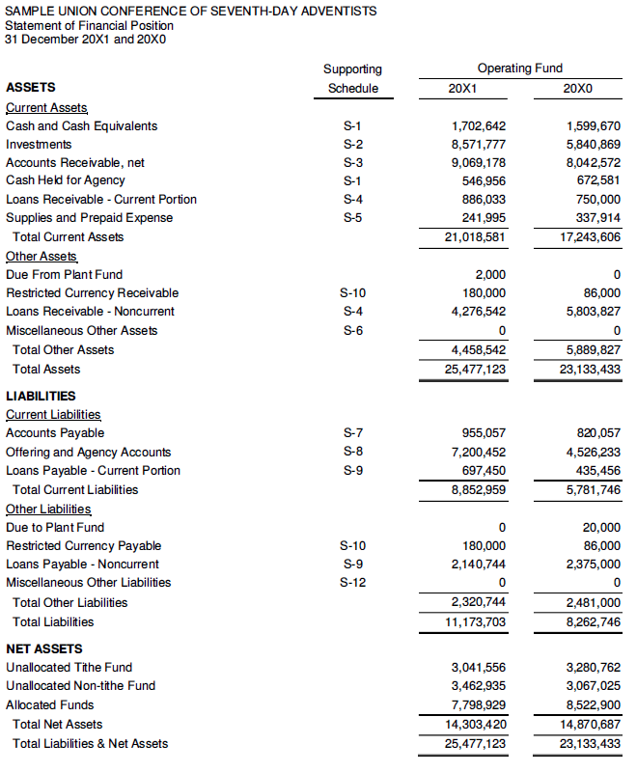
Statement of Financial Position
Sub-totals: Indicates amounts that are referred to frequently and are often used in common ratios and analyses.
Notes:
International Model -- Operating Fund only
With some edits for clarification and simplification

Slide 15
Accounting Equation
Liabilities
Net Assets
Assets
OR
Assets – Liabilities = Net Assets
Notes:
The layout of this statement relates to what is know as the Accounting Equation:
Assets = Liabilities + Net Assets.

Slide 16
Statement of Financial Position
Notes:
International Model -- Operating Fund only
With some edits for clarification and simplification

Slide 17
Assets are an item of value that is owned by the organization.
Assets are:
Listed in order of liquidity
Most liquid to least liquid
Statement of Financial Position
Current Assets are assumed to be used or convertible to cash within 12 months
Other Assets are convertible to cash over a longer period
Notes:
International Model -- Operating Fund only
With some edits for clarification and simplification

Slide 18
Cash & Cash Equivalents: Are held for operating purposes and include currency, coins, checking/savings accounts, certificates of deposit and investments convertible to cash in less than 90 days.
Statement of Financial Position
Investments: Include financial securities such as time deposits convertible to cash in more than 90 days, stocks, bonds, etc.
The types of investments which may be held are subject to provisions of GC Working Policy S 85.
Notes:
International Model -- Operating Fund only
With some edits for clarification and simplification

Slide 19
Accounts Receivable, net: Amounts due from people or organizations, such as employees, local churches, academies, institutions, etc.
Loans Receivable – Current Portion: This represents the principal portion of long-term loans given to others that is scheduled to be received within twelve months.
Statement of Financial Position
Loans Receivable – Noncurrent Portion: This represents the principal portion of long-term loans given to others that is scheduled to be received beyond twelve months.
Notes:
International Model -- Operating Fund only
With some edits for clarification and simplification

Slide 20
Statement of Financial Position
Liabilities are forms of debt that are owed to individuals or another entity.
Liabilities are:
Listed in order of how soon they must be paid
Those higher in the list must be paid earlier
Notes:
International Model -- Operating Fund only
With some edits for clarification and simplification

Slide 21
Accounts Payable: Amounts due to people or organizations, such as employees, local churches, academies, institutions, higher organization, etc.
Offering and Agency Accounts: This represents Tithe percentages and offerings due to the higher organization. Also includes money held for others as a short-term arrangement.
Statement of Financial Position
Notes:
International Model -- Operating Fund only
With some edits for clarification and simplification

Slide 22
Statement of Financial Position
Loans Payable – Current Portion: This represents the principal portion of long-term debt that is scheduled to be paid within twelve months.
Loans Payable – Noncurrent Portion: This represents the principal portion of long-term debt that is scheduled to be paid beyond twelve months.
Notes:
International Model -- Operating Fund only
With some edits for clarification and simplification

Slide 23
Net Assets: Represents the net residual of gains and losses over the years from the time the organization was established.
Unallocated Tithe Fund: The portion of net assets originating from Tithe income.
Statement of Financial Position
Unallocated Non-tithe Fund: The portion of net assets originating from Non-tithe income.
Allocated Funds: The portion of net assets allocated by the controlling committee for specific purposes.
Notes:
International Model -- Operating Fund only
With some edits for clarification and simplification

Slide 24
Financial Statements
Statement of Financial Position
Statement of Financial Activity
Statement of Changes in Net Assets
Statement of Cash Flows

Slide 25
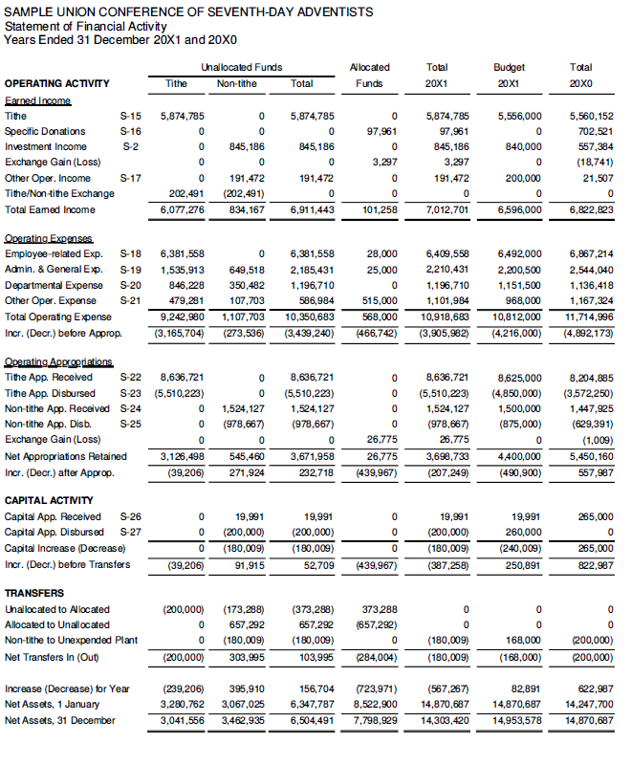
Statement of Financial Activity
Notes:
Linkage between Statement of Financial Position and Statement of Financial Activity.

Slide 26
The Statement of Financial Activity summarizes transactions by the natural classification – meaning the type of income or expense without regard to department or purpose. For example, all payroll expenses are grouped together in one line rather than separating them by department.
The following statement will categorize expenses by department or purpose.
Statement of Financial Activity
The Statement of Financial Activity also separates Tithe vs Non-tithe activity into separate columns.
Notes:
To briefly orient you to the Statement of Financial Activity:
Take time to look at the column headings. They are organized slightly different then the Statement of Financial Position.
The Statement of Financial Activity summarizes transactions by the natural classification – meaning the type of income or expense without regard to department or purpose. For example, all payroll expenses are grouped together in one line rather than separating them by department.
The following statement will categorize expenses by department or purpose.
The Statement of Financial Activity also separates Tithe vs Non-tithe activity into separate columns.

Slide 27
Operating Activity Is defined as the day-to-day activity of the entity. It is further divided into three sections:
Earned Income will vary depending on the type of entity producing the statement.
Statement of Financial Activity
Operating Expense may vary depending on the type of entity, but will generally be quite generic.
Operating Appropriations will not appear if the entity doesn’t receive this form of support.
Notes:
Next, we have three primary categories of activity – Operating, Capital, and Transfers
And, of course, the all-important “bottom line” or result of the financial activity for the period – Formally referred to as the “Increase (Decrease) for the Year”
For the purpose of our summary today, we will focus on the Operating Activity section.
Operating Activity Is defined as the day-to-day activity of the entity. And is further divided into three sections:
Earned Income
Operating Expense
Operating Appropriations
Depending on the type of organization, of course, the types of income will vary, and
The appropriation section will not appear if the entity doesn’t receive this form of support.

Slide 28
Financial Statements
Statement of Financial Position
Statement of Financial Activity
Statement of Changes in Net Assets
Statement of Cash Flows

Slide 29
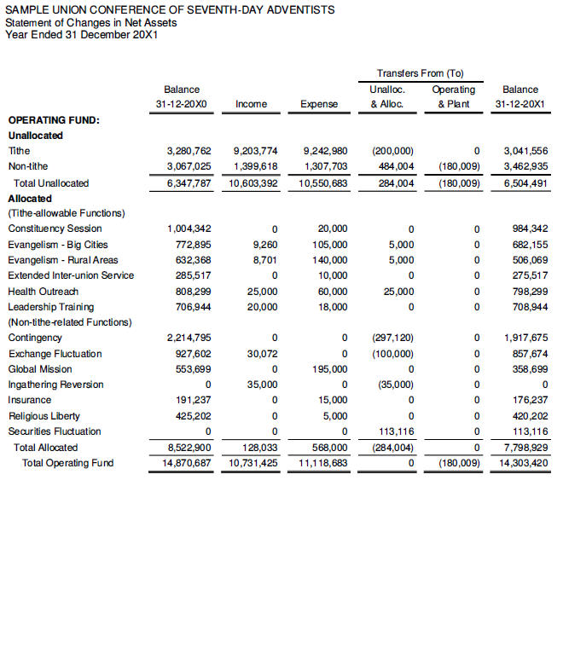
Statement of Changes in Net Assets
Notes:
Linkage between Statement of Changes in Net Assets and Statement of Financial Activity and Statement of Financial Position.

Slide 30
The Statement of Changes in Net Assets summarizes the transactions by the functional classification – meaning the purpose of income or expense.
For example, all leadership training income, expense, and beginning and ending balances are displayed together in one line rather than separating them by type of expense.
Statement of Changes in Net Assets
Notes:
The Statement of Changes in Net Assets summarizes the transactions by the functional classification – meaning the purpose of income or expense.
The far left column provides the name of the various functions or purposes
By way of example, all leadership training income, expense, and beginning and ending balances are displayed together in one line rather than separating them by type of expense.

Slide 31
The Statement of Changes in Net Assets summarizes the transactions by the functional classification – meaning the purpose of income or expense.
For example, all leadership training income, expense, and beginning and ending balances are displayed together in one line rather than separating them by type of expense.
Statement of Changes in Net Assets

Slide 32
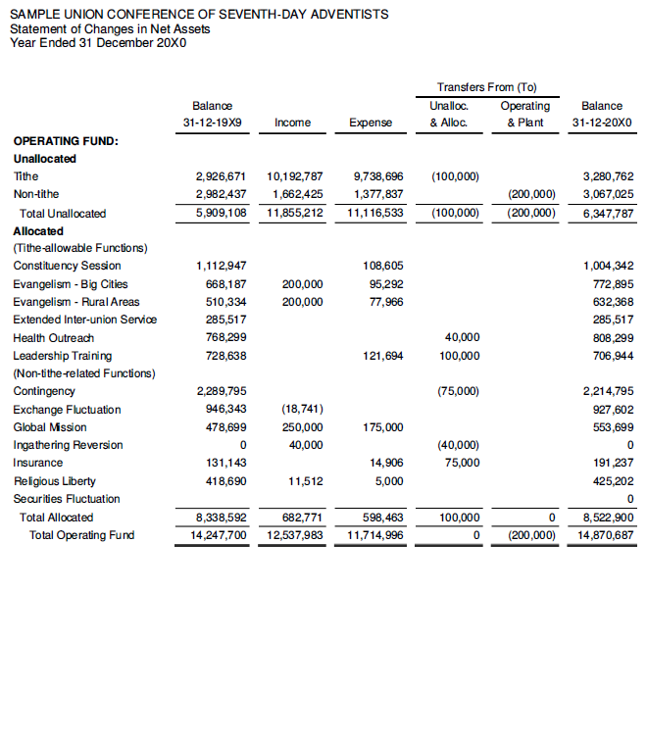
Statement of Changes in Net Assets
Notes:
Often, in order highlight trends that may have occurred, the Statement of Changes in Net Assets will include a second page to show the prior year activity in the same format.

Slide 33
Financial Statements
Statement of Financial Position
Statement of Financial Activity
Statement of Changes in Net Assets
Statement of Cash Flows

Slide 34
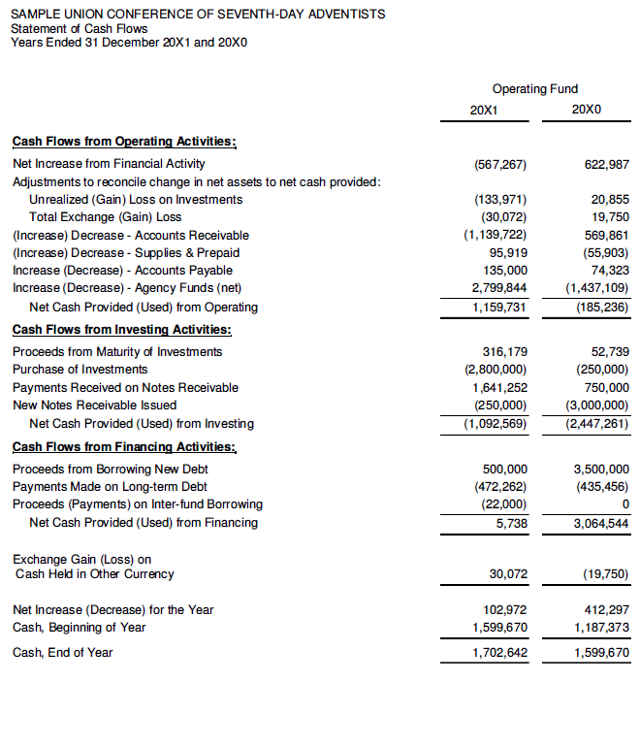
Statement of Cash Flows
Notes:
Now, as we have with the other statements lets take a quick look at how the Statement of Cash Flows ties together with the Statement of Financial Position.

Slide 35
Statement of Changes in Cash Flow exists because of the critical nature of cash for every organization. It summarizes the major cash flows during the year that impacted the change in the total cash.
Statement of Cash Flows
In this example, it can be seen that Accounts Receivable increased by 1.1 million thereby decreasing cash by the same amount.
In the next year, management can increase cash by improving collection efforts and reducing Accounts Receivable.
Notes:
Statement of Changes in Cash Flow exists because of the critical nature of cash for every organization. It summarizes the major cash flows during the year that impacted the change in the total cash.
This statement is divided into three sections:
Operating activities
Investing activities
Financing activities
In this example, it can be seen that Accounts Receivable increased by 1.1 million thereby decreasing cash by the same amount.
In the next year, management can increase cash by improving collection efforts and reducing Accounts Receivable.

Slide 36
Understanding Financial Statements
Notes:
So now that we have discussed the purpose of financial statements and are familiar with how to read them, lets move on to a brief discussion of how to understand Financial Statements.

Slide 37
What are you seeking to Understand?
Financial Health and Sustainability
Operational Efficiency and Effectiveness
Missional alignment
Notes:
What are you seeking to Understand?
Financial Health and Sustainability
Operational Efficiency and Effectiveness
Missional alignment
In order to assess these three aspects, it is helpful to be aware of:
Context
Trends
Comparisons

Slide 38
Context
It is important to understand:
Where are we?
Macro-economic situation?
Point in business cycle?
What are we?
Type of entity?
Notes:
Very few things in this world ever stand alone. Therefore, when examining the financial statements, we must be aware of the context.
It is important to understand:
Where are we?
Macro-economic situation?
Point in business cycle?
What are we?
Type of entity?
Ecclesiastical
Educational
Healthcare
Publishing institution

Slide 39
Trends
Are there any recognizable patterns?
Time
Between various points in time, or
Relative to a goal or deadline
Direction
Where are we heading?
Velocity
How fast are we moving?
Momentum or Inertia
Relative ability to change direction
Notes:
After understanding the context, we are prepared to look for emerging Trends.
Time
Between various points in time, or
Relative to a goal or deadline
Direction
Where are we heading?
Velocity
How fast are we moving in that direction?
Momentum or Inertia
Regarding the relative ability to reach full speed or to change direction. Think of a large ocean-going ship.

Slide 40
Comparisons
Internal
Strength or weakness of specific components
Consistency between specific components
External
What is the current situation and experience of similar entities?
How does my organization compare to the typical entity (or ideally the “best in class”)?
Notes:
One of the ways this can be done is by making comparison both internally and externally:
Internal
Strength or weakness of specific components
Consistency between specific components
External
What is the current situation and experience of similar entities?
How does my organization compare to the typical entity (or the “best in class”)?

Slide 41
Financial Analysis
Common-size analysis
Converts the various amounts into a % of a major item
Such as Tithe or Sales or Assets, etc.
Ratio analysis
Relationships between two or more numbers
Relationship between multiple ratios
Notes:
We started our journey to understanding by reviewing Context, Trends and Comparisons.
Now we will turn to performing specific analyses in our own financial statements.
Common-size analysis
Converts amounts into a % of a major item
Such as Tithe or Sales or Assets, etc.
We can then examine whether Payroll is growing when compared with total expense or shrinking.
Removes some elements of the impact of the size of an organization over multiple years or when comparing with a second entity.
Ratio analysis
Relationships between two or more numbers
Relationship between multiple ratios

Slide 42
Financial Position Ratios
To analyze the relative health of the entity at a point in time
These include:
Liquid Assets to Commitments
Recommended Working Capital
Current Ratio
Debt Percentage
Equity (Net Asset) Percentage
SDA Accounting Manual - January 2011 – page 14
Notes:
To analyze the relative health of the entity at a point in time

Slide 43
Operating Activity Ratios
To analyze the relative efficiency/effectiveness of the entity’s operations over a period of time
These include:
Self-Support
Net Income to Sales
Gross Profit to Sales
Operating Expense to Sales
Payroll Expense to Tithe
Collection Ratio
Accounts Receivable Turnover
Inventory Turnover
SDA Accounting Manual - January 2011 – page 149
Notes:
To analyze the relative efficiency/effectiveness of the entity’s operations over a period of time

Slide 44
Find the “Pulse” of the Organization
Sources
Ask your treasurer
Ask your higher organization
Ask your lender / loan covenants
Experience over time
May change
Over time
At various points in business cycles or economic conditions
Notes:
Ultimately, the most important thing is to find the “pulse” or the organization.
Find a few key metrics that will tell you:
if it is alive?
if it is healthy?
Sources
Ask your treasurer
Ask your higher organization
Ask the previous treasurer
Ask your lender / loan covenants
Experience over time
Remember that some of these may change
Over time
At various points in business cycles or economic conditions

Slide 45
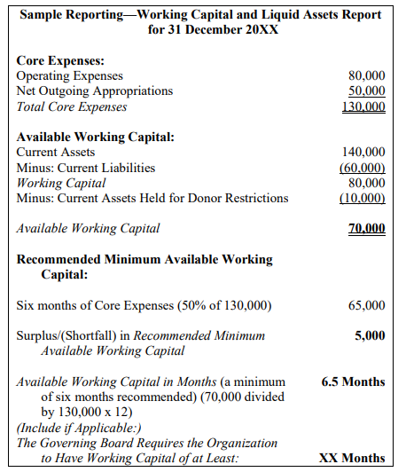
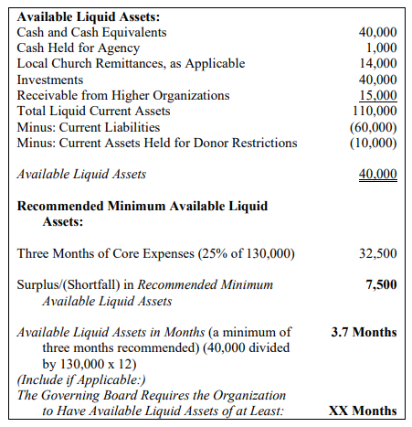
GCWP S 24 25 -- Reporting on Working Capital and Liquidity
GCWP S 24 25 Reporting on Working Capital and Liquidity
Notes:
Many years ago, as a denomination we settled on two measures that have become popular indicators of the health of our organizations.
Working Capital, and
Liquidity.
These were updated in 2021 to take effect this year in 2023.
The primary new emphasis is on the number of months of Working Capital and Liquidity held by the organization.
In this example, WC is 6.5 months compared to the recommended 6 months.
Liquidity is 3.7 months compared to 3.7 months.

Slide 46
Thank you!
Notes:
Thank you for your time.
I trust that this presentation has been helpful to you as you continue to grow in your new positions as financially aware leaders.

Slide 47
Bibliography
Galasso, Melisa F., CPA, Money Matters For NonProfits, River Grove Books, Austin, TX, USA, 2022
Seventh-day Adventist Accounting Manual, January 2011 Edition, https://www.gcasconnect.org/assets/files/manuals/SDAAM_Jan_2011_Final.pdf?_ga=2.195916204.1296290738.1678485819-1638045833.1678485819
General Conference Working Policy, 2023-2024 Edition

