Slide 1
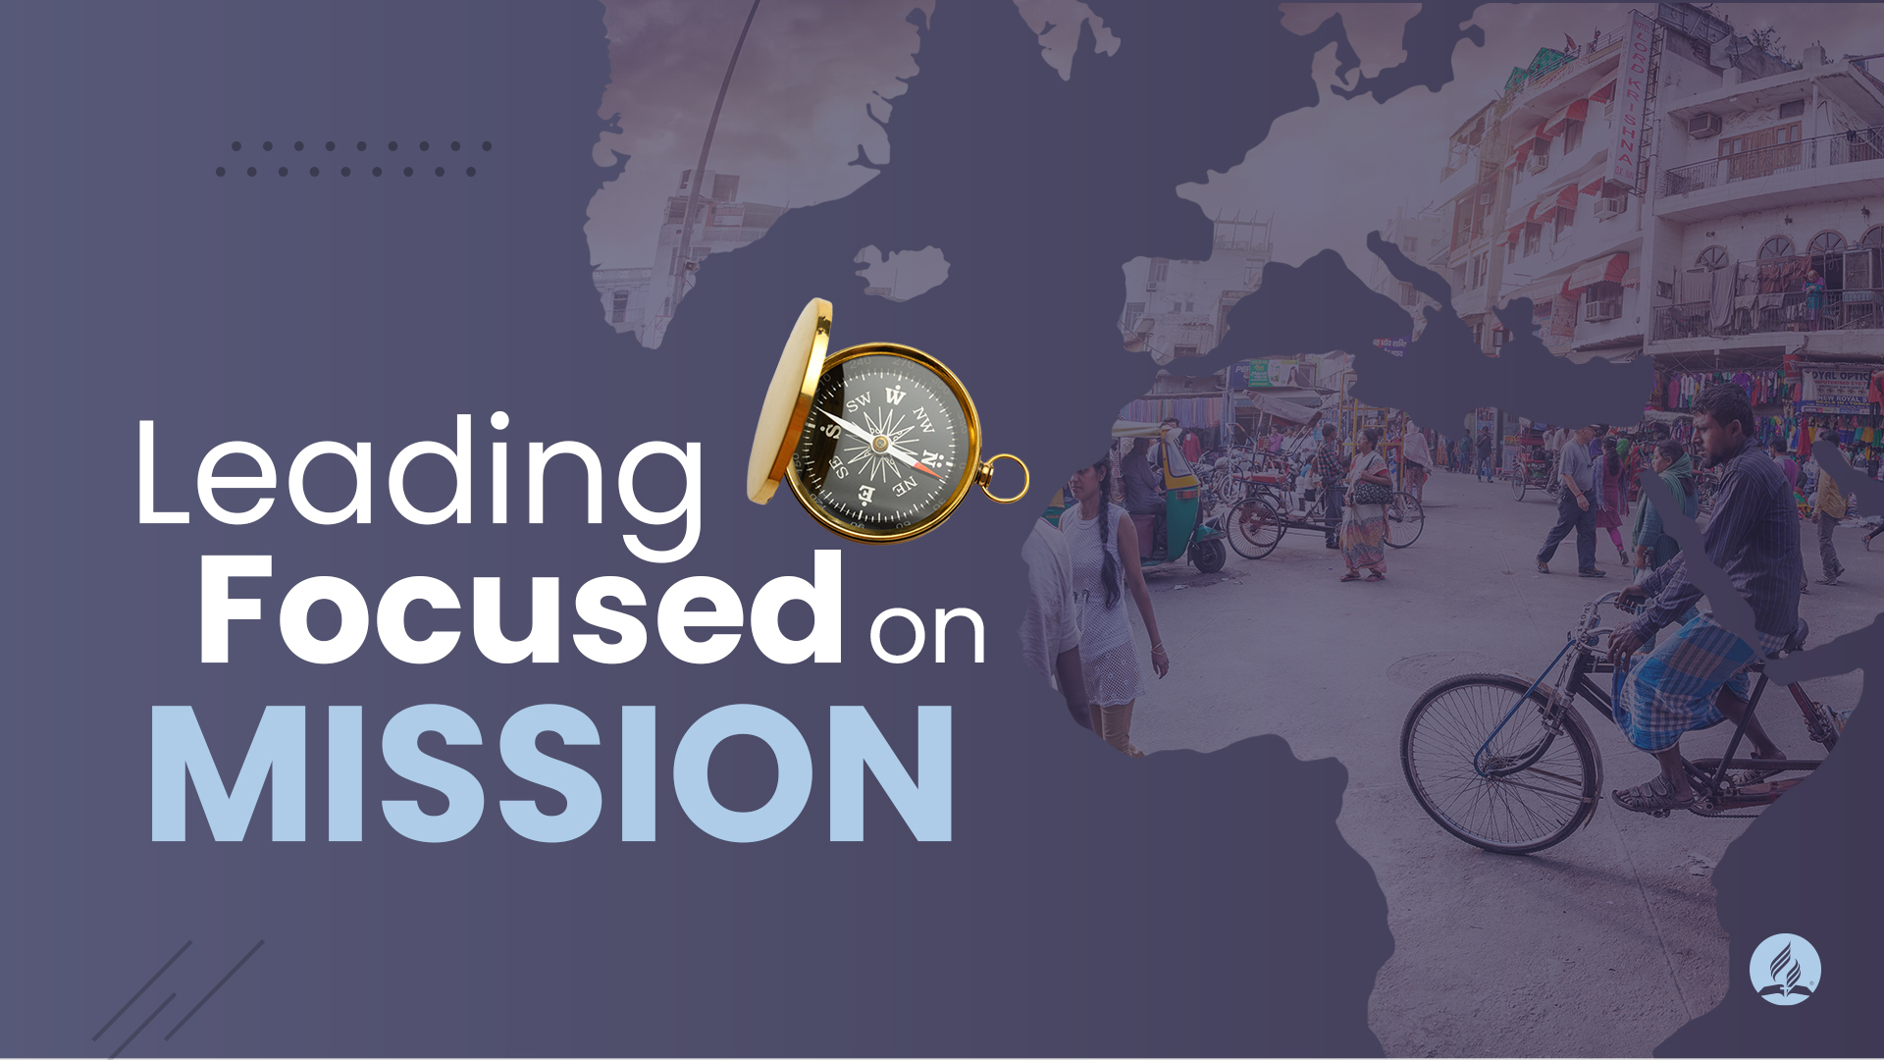

Slide 2


Slide 3

If we are not focused on mission, we are hiding the patient’s medicine.

Slide 4

What exactly is our mission?

Slide 5
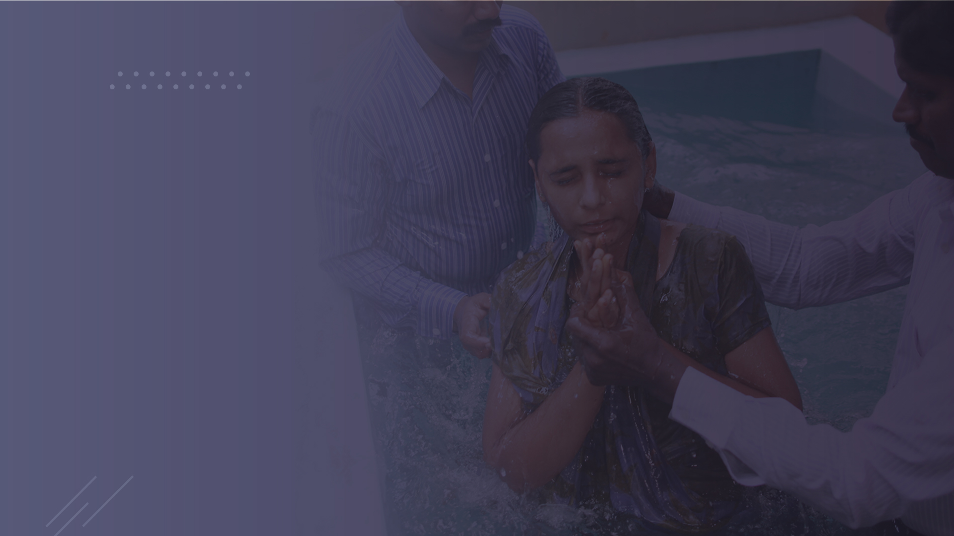
Our mission is to prepare a people for the
RETURN
OF JESUS.

Slide 6

Internal perspective
External perspective

Slide 7
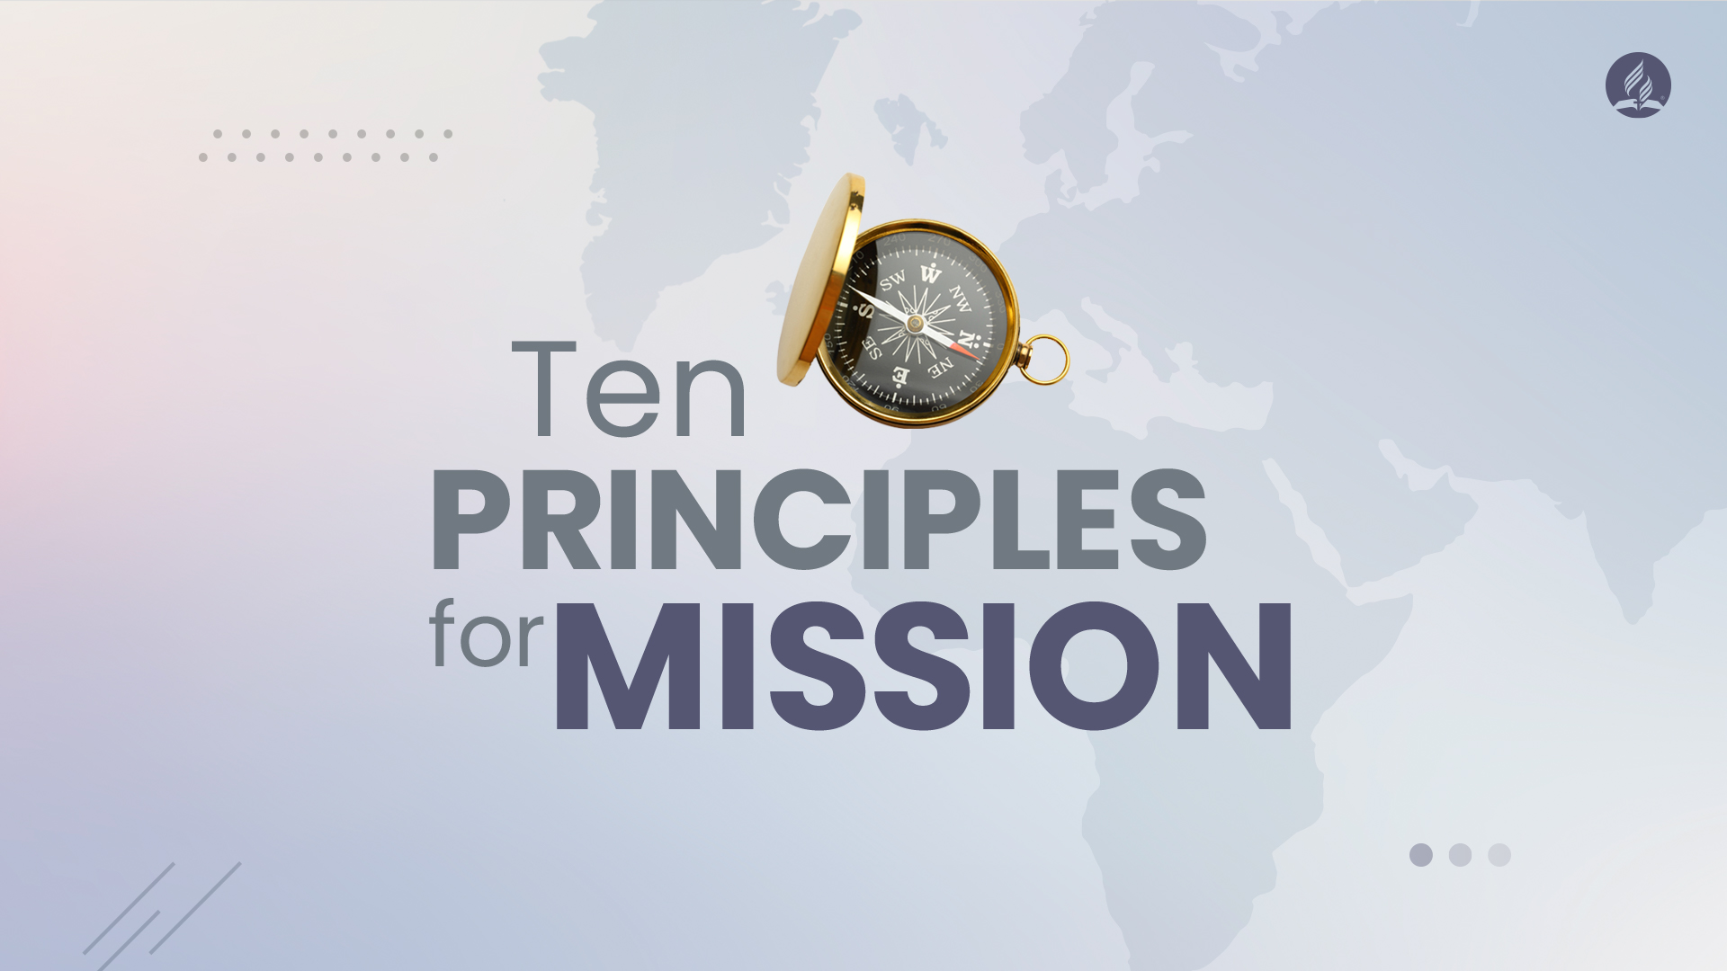

Slide 8

We are called to lead a mission, not an institution.

Slide 9

We are not a Church that has a mission, but a mission that has a Church.

Slide 10

We are in the business of mission.

Slide 11

You were called to fish for fishes and
not to take care of aquariums.

Slide 12

In a special sense Seventh-day Adventists have been set in the world as watchmen and light bearers. To them has been entrusted the last warning for a perishing world. On them is shining wonderful light from the word of God. They have been given a work of the most solemn import—the proclamation of the first, second, and third angels’ messages. There is no other work of so great importance. They are to allow nothing else to absorb their attention.
Ellen White, Testimonies for the Church, V. 9, p. 19

Slide 13

When mission is the priority of the Church, it needs to be the priority of each area and organization.

Slide 14
Without careful attention, faith-based organizations will inevitably drift from their founding mission.
Peter Greer and Chris Horst, Mission Drift, p. 15

Slide 15

Keep the right focus alive in each one of your initiatives.

Slide 16

If mission is a priority, we will see it reflected in the way we spend and invest our financial resources.

Slide 17

Frequent evaluations avoid transforming our movement in just a monument.

Slide 18

Mission keeps our priorities aligned with
God's priorities.

Slide 19

The mission has local involvement and global support.

Slide 20

We are a "GLOCAL" church.

Slide 21
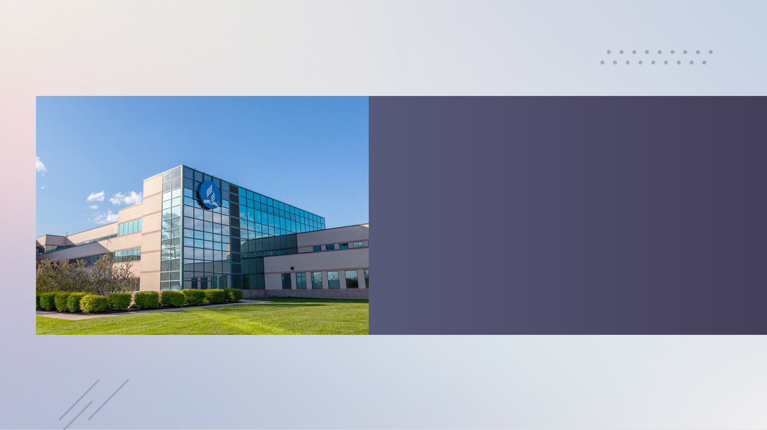
The role of the GC is to provide opportunities for the entire family to be involved both in the local and global mission.

Slide 22
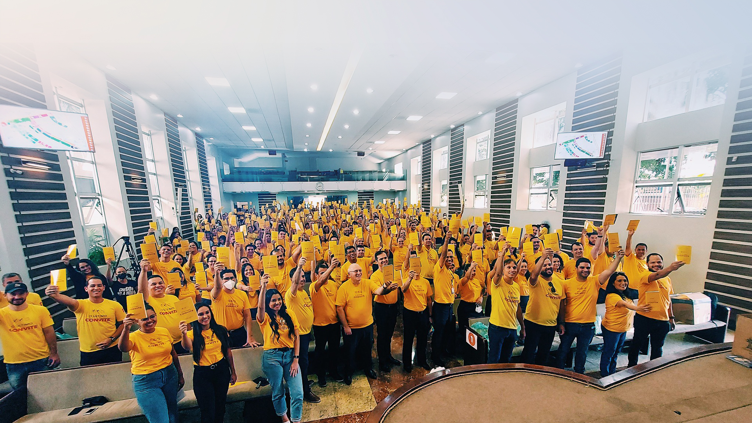
Jesus will not come only for some areas of
the world where the Church is strong,
dynamic and mission focused.

Slide 23
His kingdom will not come until the good tidings of His grace have been carried to all the earth.
Ellen White, Thoughts from the Mount of Blessing, p. 108

Slide 24

Be a leader with a local mind and global heart.

Slide 25

Effective mission is simple, bold, and relevant.

Slide 26

Mission or any project no more than 10 minutes and a sheet of paper.

Slide 27

Mission needs to involve everybody, everywhere.

Slide 28

Mission involves integration.

Slide 29
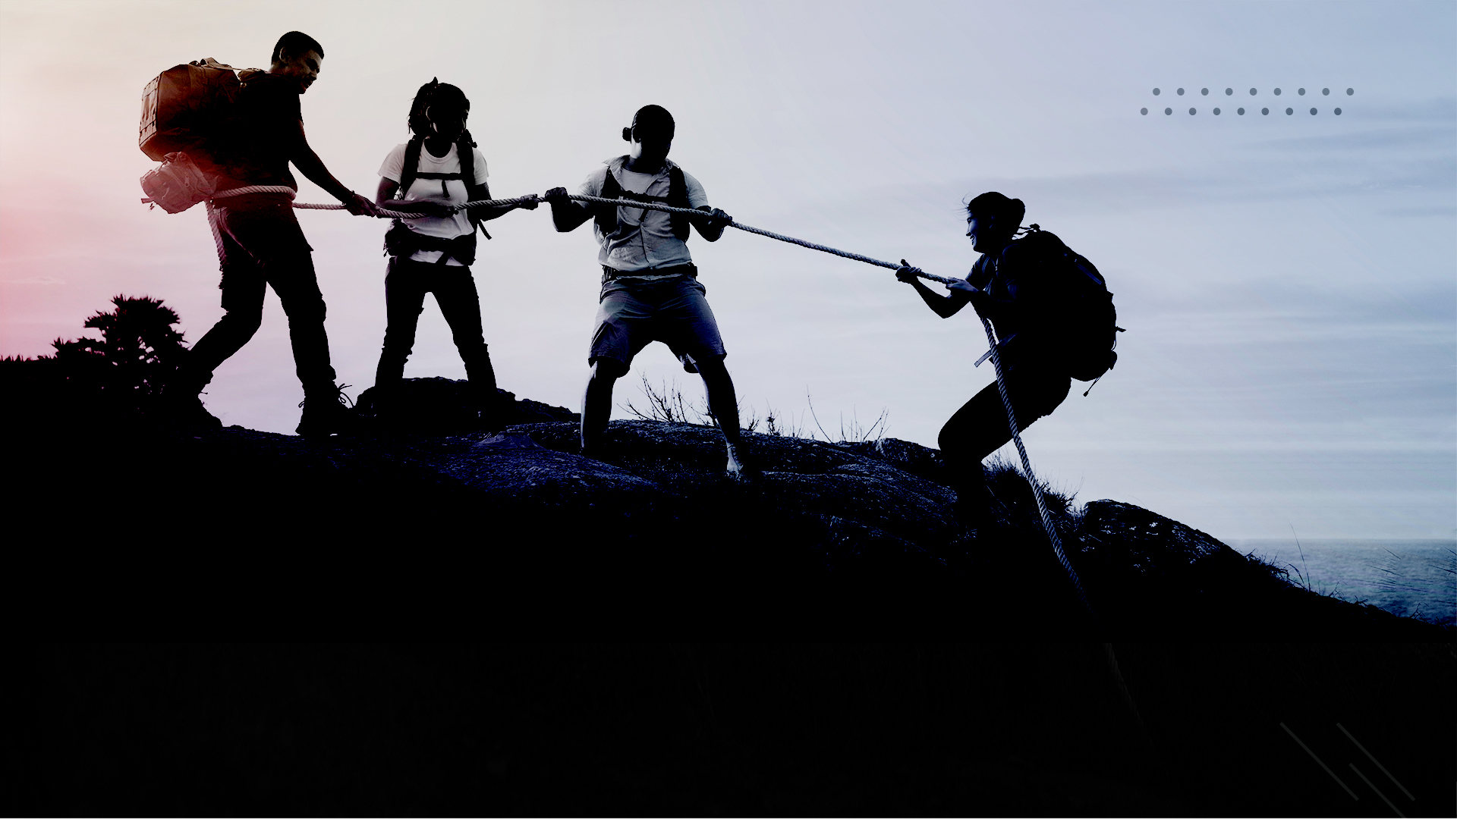
Integrated we are always stronger; we go further, and we go faster.

Slide 30

What is integration?

Slide 31


Slide 32
We are coming to a time when, more than ever before, we shall need to press together, to labor unitedly. In union there is strength.
Ellen White, Selected Messages, Book 2, p. 373

Slide 33

Mission produces multiplication.

Slide 34

If Jesus sent us to the harvest, it is because the harvest is real.
He will not send laborers to harvest what doesn't exist.

Slide 35
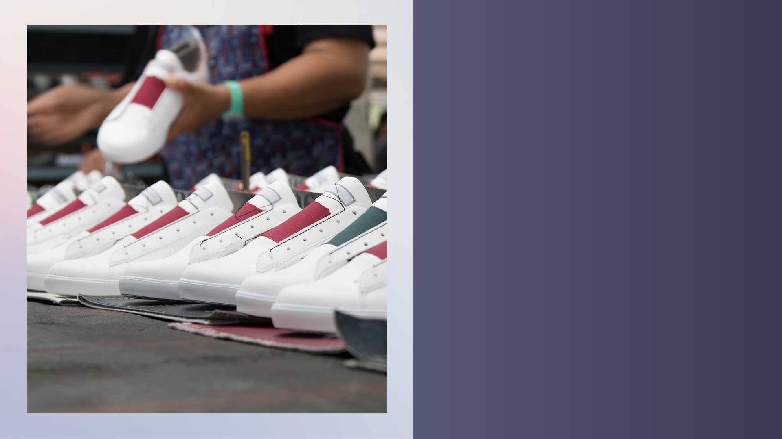
Mission produces results.

Slide 36

All living things grow.

Slide 37

Mission is a result of disciple-making.

Slide 38

Disciple-making is people taking care of people to multiply more people.

Slide 39

Head
To follow Christ
Three main characteristics of Disciple-making:
1
2
Heart
To be transformed by Christ
3
Hands
To share Christ with others
Jim Putman and Bobby Harrington, Discipleshift, p. 51

Slide 40
In the mission we lead people to be disciples. In disciple-making we lead people back to the mission.
Bill Hull

Slide 41

Disciple-making is multiplication multiplication multiplication multiplication multiplication

Slide 42

The main result of mission is to fill heaven, and not only to fill a church.

Slide 43

The Church is
a channel to connect people to Jesus and prepare them for heaven.

Slide 44

Mission depends on the message.

Slide 45

The message gives identity to our mission.

Slide 46

If the identity is clearer, the mission is stronger.

Slide 47

Mission is a miracle.

Slide 48

Mission is not about our work for God, but about
God's work through us.

Slide 49
We do not wrestle against flesh and blood, but against principalities, against powers, against the rulers of the darkness of this age, against spiritual hosts of wickedness in the heavenly places.
Ephesians 6:12

Slide 50

Move forward with a sense of urgency.

Slide 51

When mission comes first, money will follow later.

Slide 52

Mission is a miracle.

Slide 53
Someone that is not committed to mission is like a firefighter who runs into a burning building just to fix a painting on the wall.
Dwight Moody

Slide 54
God will have people who will venture anything and everything to save souls.
Ellen White, Evangelism, p. 63

Slide 55
A boat in the harbor is safe and secure, but that is not what boats were built for.
John A. Shedd

Slide 56

Those who do God's work, using God's methods, will achieve God's results.

