Slide 1
THE ROLE OF A PRESIDENT IN 21ST CENTURY CHURCH ORGANIZATION
Ted N C Wilson

Slide 2
FACILITATING MISSION DECISIONS AND ACTIONS
1
LEADER IN
Collegial
Cordial
Christlike
2 Corinthians 5:18-19

Slide 3
SPIRITUAL INFLUENCE
2
LEADER IN
Asks for the presence of the Holy Spirit
Prays earnestly
Shares spiritual lessons
The Bible is a constant companion
2 Timothy 4:2; John 21:16

Slide 4
KINDNESS, GENEROSITY, AND BALANCED PERSONAL APPROACH
3
LEADER IN
Approachable
Willing to give time
Impartial interactions
Philippians 4:8; Proverbs 1:5; Proverbs 15:23

Slide 5
VISIONARY PLANS, BUT PRACTICAL APPLICATION
4
LEADER IN
Spend time reflecting
Plan future outreach
Quiet time for review and analysis
2 Timothy 2:15; Mark 6:46

Slide 6
PRAYER
5
LEADER IN
Not just an exercise but an integral part of earnestly seeking God
Should be the hallmark of all leaders
Prayer solves problems
Produces revival and reformation
1 Thessalonians 5:17; Revelation 3:18-20

Slide 7
AND PROPONENT OF HEALTH REFORM
6
LEADER IN
Best health possible
Follow appropriate counsels
Set the tone
3 John 2; 1 Corinthians 10:31; 1 Corinthians 6:19-20

Slide 8
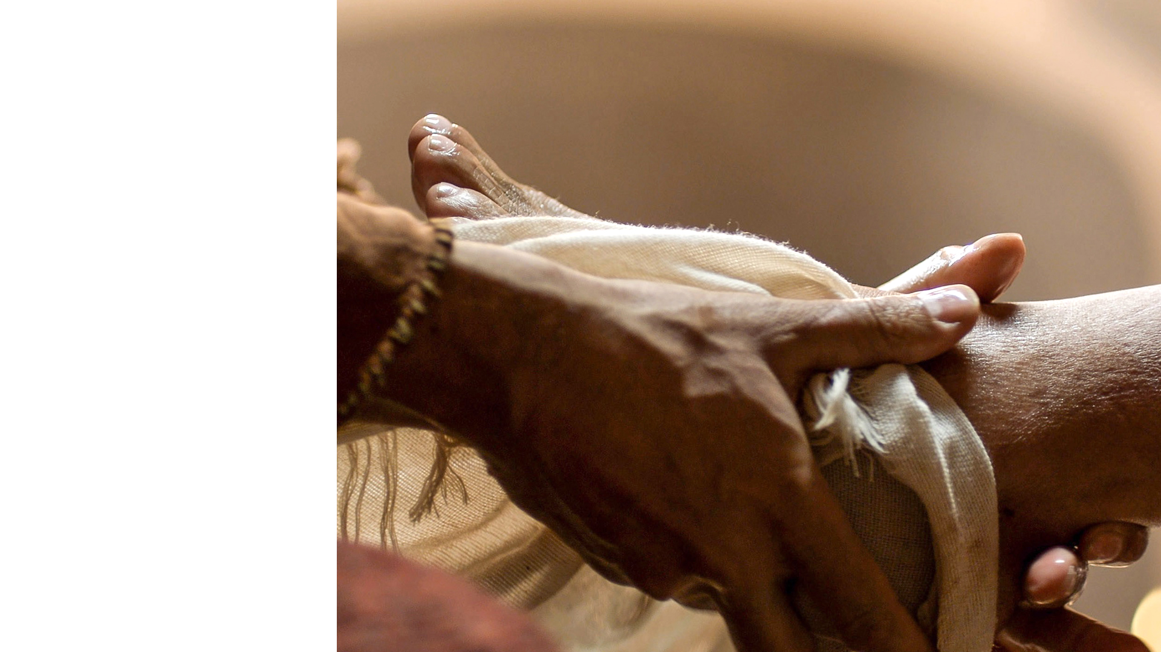
SERVANT LEADERSHIP INFLUENCE
7
LEADER IN
Be a servant
Exhibit genuine humility
Matthew 20:26-28; Proverbs 3:7; Proverbs 15:33

Slide 9
BELIEF OF THE BIBLE, SPIRIT OF PROPHECY, 28 FUNDAMENTAL BELIEFS, AND THE MISSION OF THE CHURCH
8
LEADER IN
Strong belief in the essential reason for the church
Chief promoter of God’s truth
No hesitation or question about the loyalty of the president to the tenets and beliefs of the church
Joshua 24:15; Luke 4:18-19; Psalm 119:11; Hebrews 4:12

Slide 10
SUPPORT OF CHURCH ORGANIZATION, POLICY, AND UNITY
9
LEADER IN
Strongest support of the church organization
Strongest supporter of collective decisions
Takes a leading role in knowing church policies and adhering to them
1 Corinthians 14:40

Slide 11
PROPER ROLES: THE ROLE OF THE PRESIDENT IS NOT TO BE THE SECRETARY OR TREASURER
10
LEADER IN
Don’t overtake the role of fellow officers
Help steer in a collective manner
Romans 12:10

Slide 12
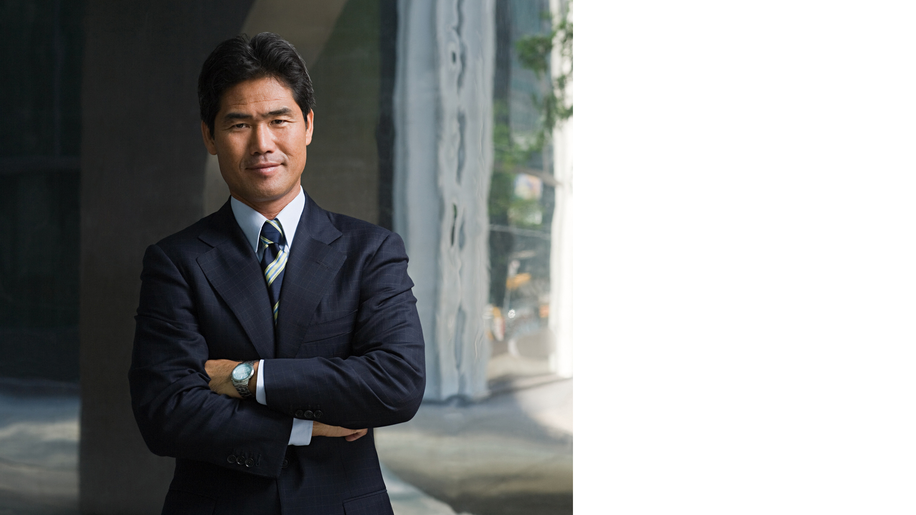
PERSONAL AND ORGANIZATIONAL FINANCIAL INTEGRITY
11
LEADER IN
Avoid conflicts of interest
Promote financial transparency
Show a high mark of integrity
Demonstrate a careful use of funds
1 Timothy 5:7; 1 Timothy 3:2

Slide 13
EVANGELISTIC AND OUTREACH ACTIVITIES
12
LEADER IN
Takes an active and personal role in personal and public evangelism outreach
Matthew 28:19-20; Matthew 24:14; Mark 16:15

Slide 14
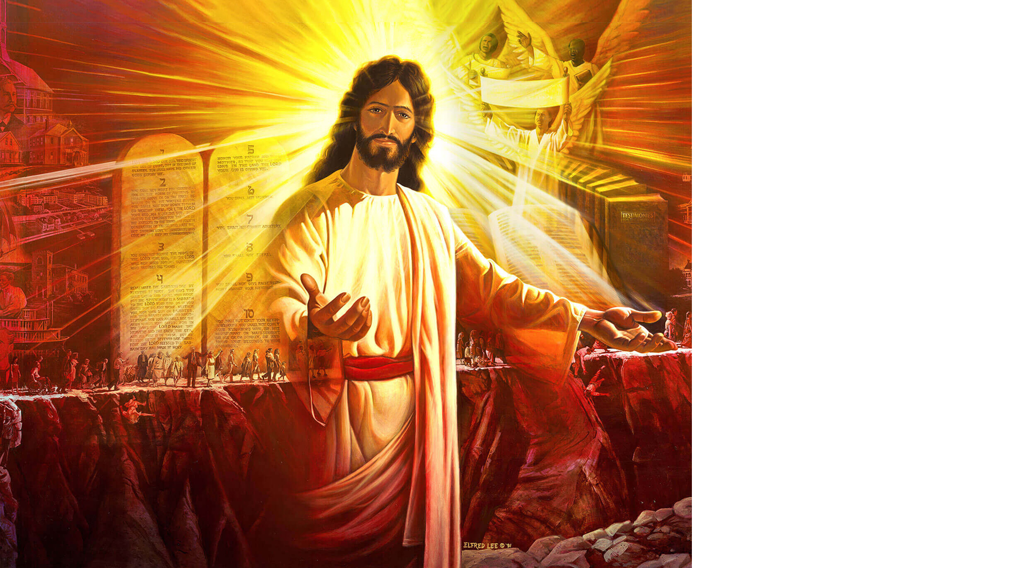
POINTING PEOPLE TO THE SOURCE OF ALL POWER WHO IS LEADING THIS ADVENT MOVEMENT TOWARDS THE SECOND COMING OF CHRIST
13
LEADER IN
Complete faith in the Seventh-day Adventist movement
1 Peter 1:17-21; Matthew 24:29-31; 2 Peter 3:9-13

Slide 15
SEEKING COUNSEL FROM GOD AND OTHER COLLEAGUES
14
LEADER IN
Recognize the role of seeking counsel
Confer with trusted, godly colleagues
Proverbs 11:14; James 1:5

Slide 16
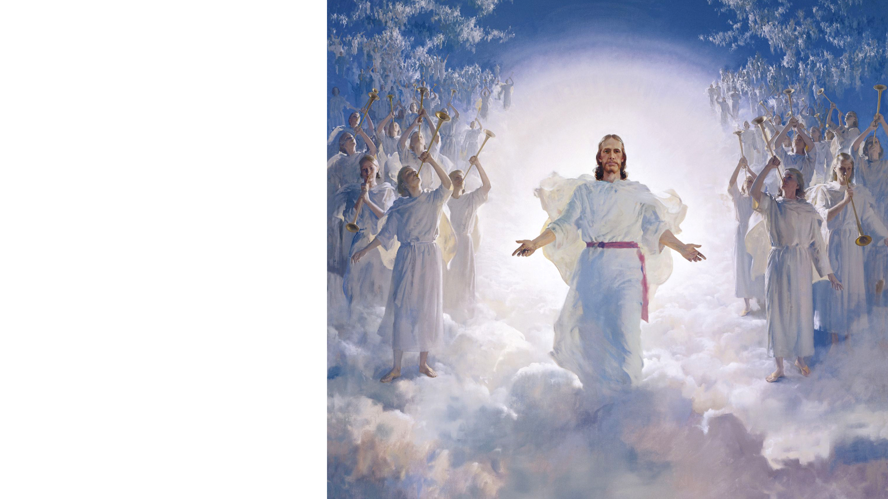
ALLOWING THE HOLY SPIRIT TO OPEN THE PATHWAY LEADING TO THE SECOND COMING OF CHRIST
15
LEADER IN
Advocate that God’s pathway is the only safe path
Pray for and anticipate the latter rain
Lift the mission vision
Focus on the soon coming of Christ
John 16:13; Acts 2:16-21; Revelation 22:7, 12, 20

Slide 17
“He has shown you, O man, what is good; and what does the Lord require of you but to do justly, to love mercy, and to walk humbly with your God?” —Micah 6:8

Slide 18
“Trust in the Lord with all your heart, and lean not on your own understanding; in all your ways acknowledge Him, and He shall direct your paths.” —Proverbs 3:5, 6

Slide 19
“We must have a greater nearness to God. Much less of self and much more of Jesus Christ and His grace must be brought into our everyday life.” —Selected Messages, Book 2, p. 376

Slide 20
“A revival of true godliness among us is the greatest and most urgent of all our needs. To seek this should be our first work.” —Selected Messages, Book 1, p. 121

