Slide 1
The Scriptures in My Leadership Journey
Juan R. Prestol-Puesan, PhD.

Slide 2
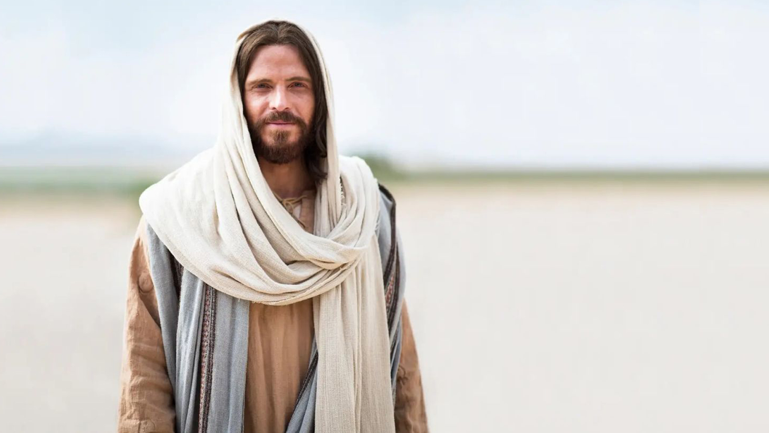
Jesus is preeminent. The person, the message, the mission.
1
John 1:1-3; 15:1-5; 17:20-24

Slide 3
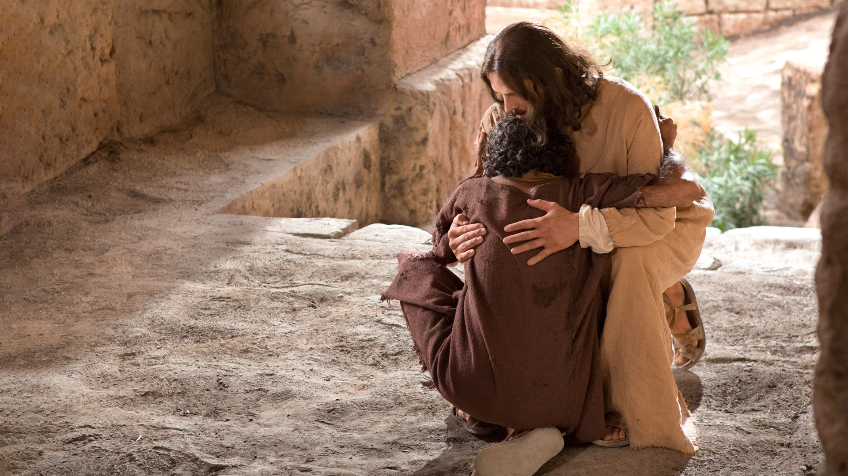
He calls to virtue. We are not leaders by accident. The God who called us will sustain us.
2
1 Peter 1:15-17

Slide 4
Perfection is not required to serve. God uses an imperfect but totally committed leader.
3
Phil. 4:19-21; James 1:5-8

Slide 5
Beware of the enemy. Satan will try to destroy you.
4
John 8:44; Job 1:6-12; Numbers 20:10-13; Deut. 3:23-28

Slide 6
Remove your ego from your decisions and treat success as perfume - Smell it but don’t swallow it.
5
Romans 12:3

Slide 7
Lessons from failures and afflictions have been transformational. Reflect on them.
6
Psalm 50:15; 1 Cor.10:13; 2 Cor.4:16,17; 12:9.

Slide 8
Prayer and personal communion with God are NOT optional. Remain connected.
7
1 Thess. 5:17; 2 Timothy 3:17

Slide 9
Be a good listener. You will go farther when you listen more and talk less.
8
Isaiah 30:19-21; Proverbs 18:21

Slide 10
9
Trust in the Lord of Mission. Rest On Him.
Isaiah 26:3,4; Jeremiah 17:7,8

Slide 11
When your time to lead comes to an end, leave gracefully, act ethically, and support your successor.
10
John 3:30

