Slide 1


Stewardship
Ministries
Resources

Slide 2
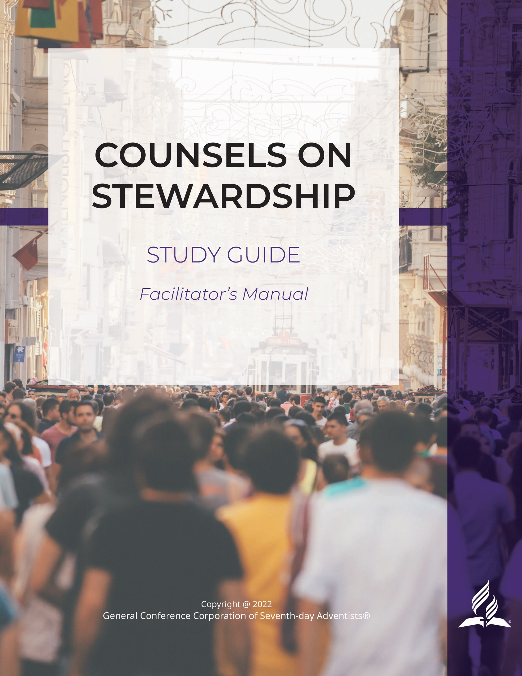

Counsels on Stewardship
https://stewardship.adventist.org/counsels-on-stewardship-study-guide

Slide 3

Strategic Orientation
https://stewardship.adventist.org/strategic-orientation-2022-2025.pdf

Slide 4
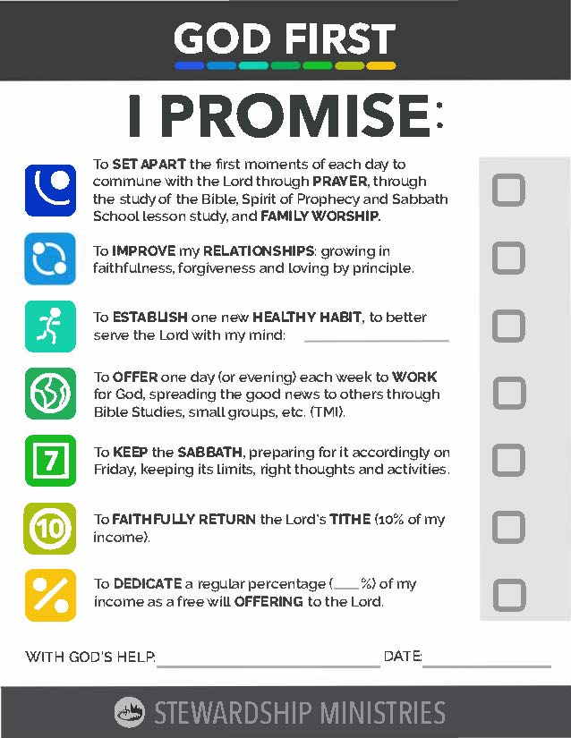
Commitment Cards
https://stewardship.adventist.org/commitment-card-promise

Slide 5

Stewardship Revival Week
https://stewardship.adventist.org/stewardship-sabbath-materials

Slide 6

Offertory Devotionals (reading/videos)
https://stewardship.adventist.org/tithe-and-offerings-readings

Slide 7

Dynamic Steward (latest edition)
https://issuu.com/dynamicstewards/docs/ds1stqtr24

Slide 8

Newsletter (latest edition)
https://stewardship.adventist.org/godfirst-newsletter%E2%80%94february-2024.pdf

Slide 9

DS/Newsletter Subscription
https://stewardship.adventist.org/magazine-subscription

Slide 10

What is Promise?
https://stewardship.adventist.org/promise-brochure.pdf

Slide 11

Promise Offerings
https://stewardship.adventist.org/promise-offerings

Slide 12

Stewardship Podcasts
https://stewardship.adventist.org/podcast-stewardship-audio-presentations

Slide 13

Books and Publications
https://stewardship.adventist.org/online-god-first-congress%E2%80%94may-8,-2024

Slide 14
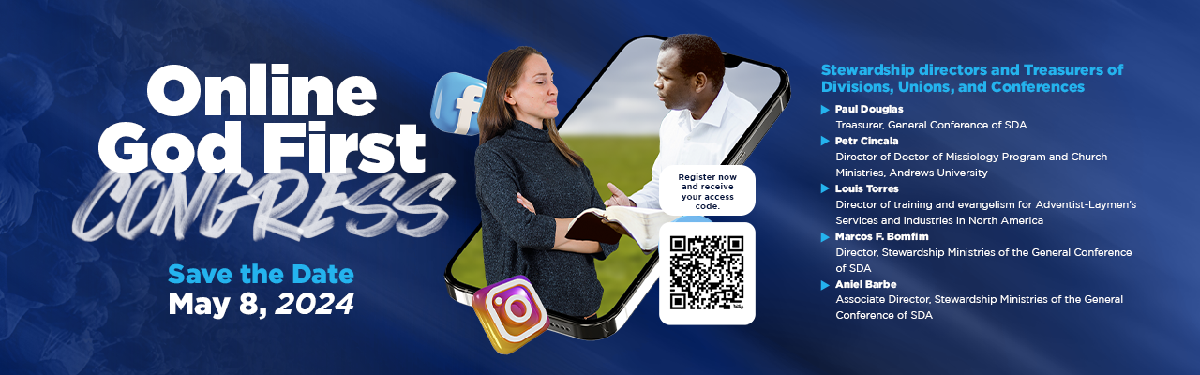
Online Congress
https://stewardship.adventist.org/online-god-first-congress%E2%80%94may-8,-2024

Slide 15
https://stewardship.adventist.org/

